Slide 1
Boosting
Based on paper by D. Cao et al. [1]

Slide 2
Boosting: General[1]
“General and effective method for producing an accurate prediction rule by combining rough” rules
A procedure to “seek for additional opinions” for incorrect classifications
AdaBoost, usually for Classification Problems
Python Library: scikit-learn
Gradient Boosting, usually for Regression Problems
Python Library: lightgbm

Slide 3
AdaBoost
Boosting technique for classification problems
Proposed by Freund, in chemistry fields
Versions
Discrete AdaBoost
Real AdaBoost
Gentle AdaBoost
AdaBoost.MH for multiclass classification

Slide 4
Discrete AdaBoost
Repeat T times with initial weight 1/N,
Sample N records from training set using the weight.
Obtain a weak learner(ex: shallow decision tree) from samples.
For each records, err=0 if correct, 1 if incorrect.
E = Sum all errors of the records, multiplied by record weight.
We have Confidence Index C=log(1-E)-log(E)
Multiply weights of incorrect records by exp(C)=(1-E)/E
Normalize the weights.
Let the ensemble of obtained learners classify the test data.

Slide 5
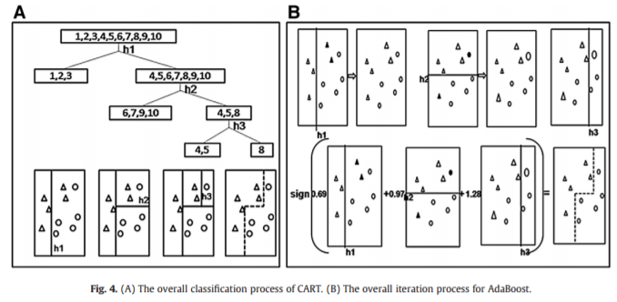
CART classification vs. AdaBoost [1]
A: Classification and regression tree (CART)
Making a overfitted decision tree first, and pruning it
B: Adaboost with 3 iterations

Slide 6
Issues on AdaBoost
Finding the optimal number of iterations is important.
Low T does not reflect the solution space well.
High T leads to overfitting.
Issue on misclassified(noisy) data
As boosting increases weights of incorrect records, misclassified data exerts significant influence on the models as the iterations goes by.
Workarounds: BrownBoost (giving up the noisy data), …

Slide 7
References
[1] D. Cao et al., "The boosting: A new idea of building models", Chemometrics and Intelligent Laboratory Systems, vol. 100, no. 1, pp. 1-11, 2010.

